Slide 1
Function name
Input
Processing
Output
Side effects

Slide 2
mean
c(1, 5, 6)
Add values and divide by the length of the vector
4

Slide 3
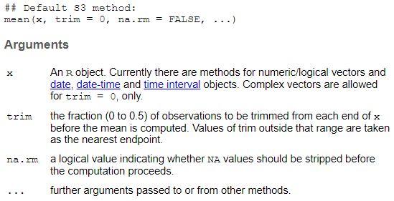

Slide 4
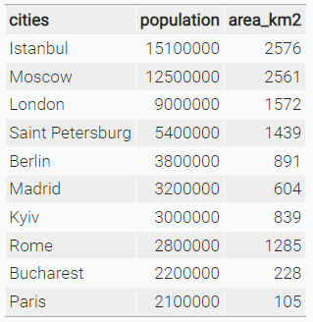
character
numeric

Slide 5
character
numeric

Slide 8





Data structure
Import
Tidy
Visualise
Transform

Slide 9
Data structure
Import
Tidy
Transform
Visualise

Slide 10
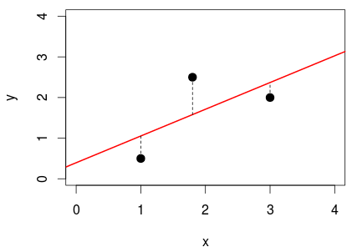

Slide 11
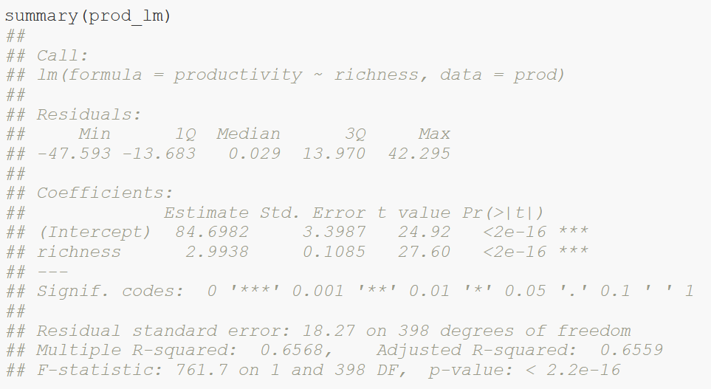
Calculated model
Distribution of residuals (errors)

Slide 12
Parameter estimates:
Intercept = 84.7
Slope = 3
Standard error of estimates

Slide 13
t-statistics: ratio of estimated parameter to its standard error

Slide 14
Coefficient of determination R²

Slide 15
F statistics: ratio of explained variance compared to null model

Slide 16
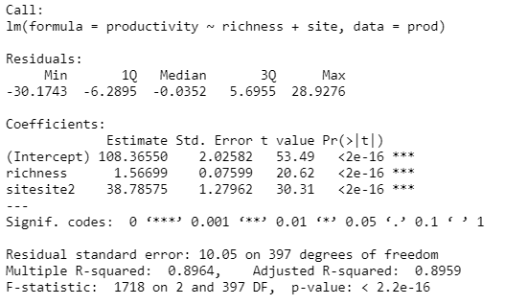
Intercept site1 = 108.4
Slope = 1.6
Intercept site2 = 108.4 + 38.8

Slide 17
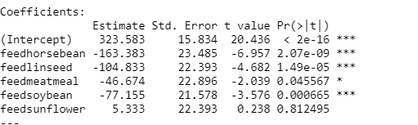
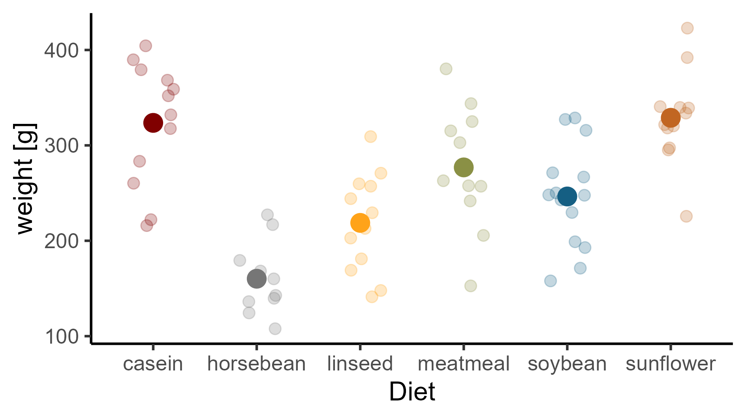
(Intercept) + feedlinseed
(Intercept) + feedsoybean
(Intercept)
(Intercept) + feedsunflower
(Intercept) + feedhorsebean
(Intercept) + feedmeatmeal

Slide 18
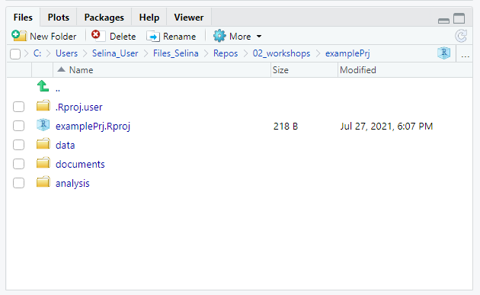
Navigate to project root
Project path
Navigate one level up
Open project in file explorer

Slide 19
Visualize
R basics
Import
Tidy
Transform
Communicate
Model
Data analysis workflow

Slide 20

Visualize
R basics
Import
Tidy
Transform
Communicate
Model
Data analysis workflow

Slide 21
Visualize
Import
Tidy
Transform
Communicate
Model
Understand

Slide 22
Visualize
Import
Tidy
Transform
Communicate
Model
Understand

Slide 23
y
No interaction
y
Interaction
x₁
X₂
a
b
x₁

